Slide 1
SQL PROJECT HOST BEHAVIOR ANALYSIS FOR PROPERTY RENTAL COMPANY
PRESENTED BY-
(GROUP 6)
AMAL AJAY
ADITYA ARYA

Slide 2
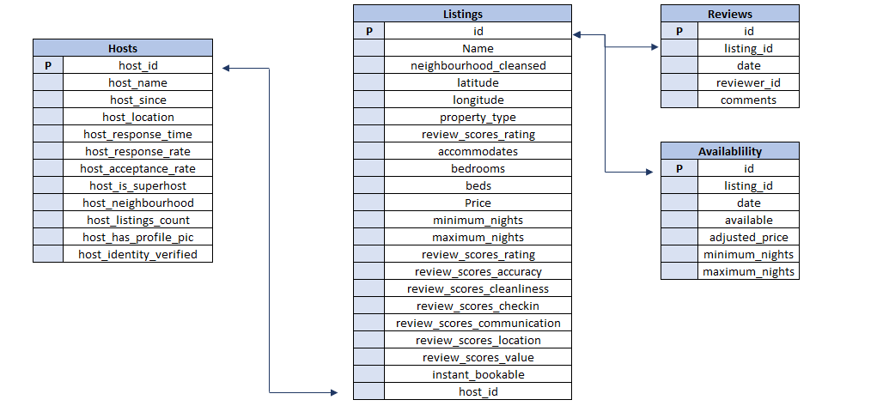
DATA OVERVIEW

Slide 3
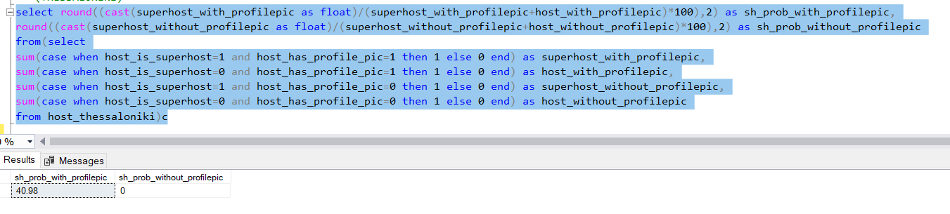
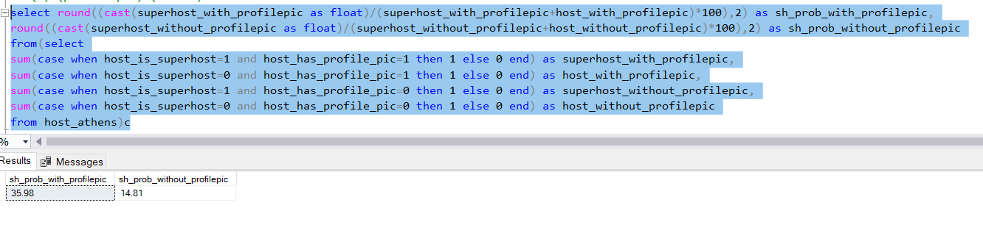
(a)Analyze different metrics to draw the distinction between Super Host and Other Hosts: To achieve this, you can use the following metrics and explore a few yourself as well. Acceptance rate, response rate, instant booking, profile picture, identity verified, review review scores, average no of bookings per month, etc.
(i) (profile pic) (THESSALONIKI)
(i) (profile pic) (ATHENS)

Slide 4
GRAPHICAL REPRESENTATION
(i) (profile pic) (ATHENS)
(i) (profile pic) (THESSALONIKI)

Slide 5
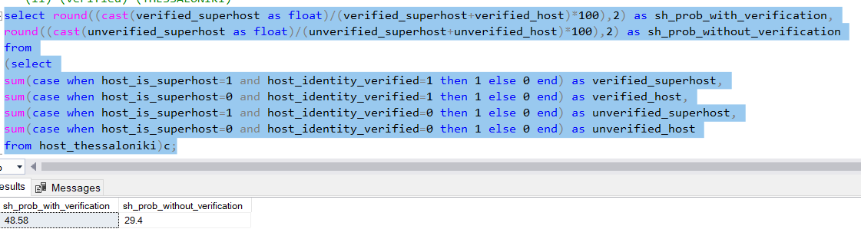
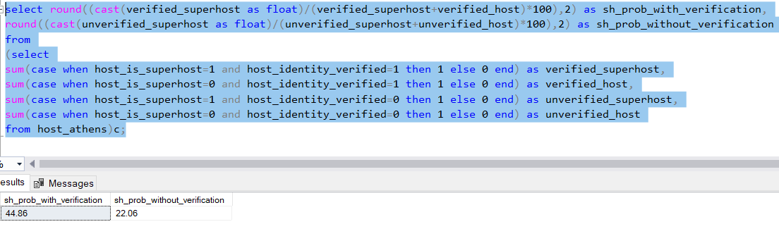
(a)Analyze different metrics to draw the distinction between Super Host and Other Hosts: To achieve this, you can use the following metrics and explore a few yourself as well. Acceptance rate, response rate, instant booking, profile picture, identity verified, review review scores, average no of bookings per month, etc.
(ii) (verified) (THESSALONIKI)
(ii) (verified) (ATHENS)

Slide 6
GRAPHICAL REPRESENTATION
(ii) (verified) (THESSALONIKI)
(ii) (verified) (ATHENS)

Slide 7
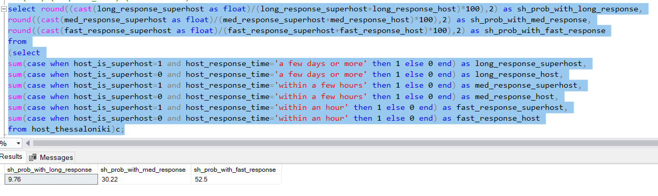
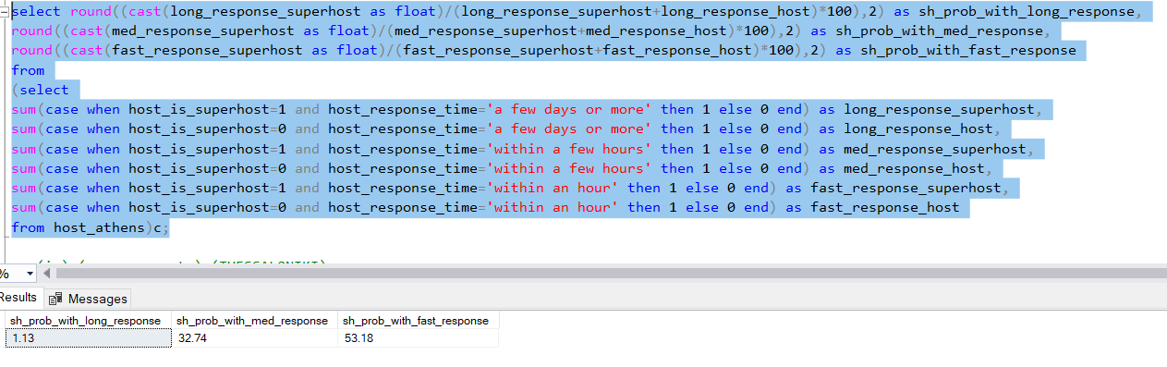
(a)Analyze different metrics to draw the distinction between Super Host and Other Hosts: To achieve this, you can use the following metrics and explore a few yourself as well. Acceptance rate, response rate, instant booking, profile picture, identity verified, review review scores, average no of bookings per month, etc.
(iii) (response time) (THESSALONIKI)
(iii) (response time) (ATHENS)

Slide 8
GRAPHICAL REPRESENTATION
(iii) (response time) (THESSALONIKI)
(iii) (response time) (ATHENS)

Slide 9
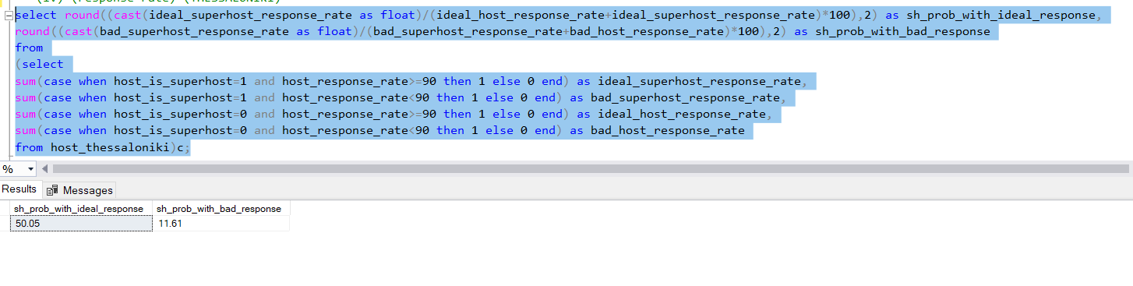
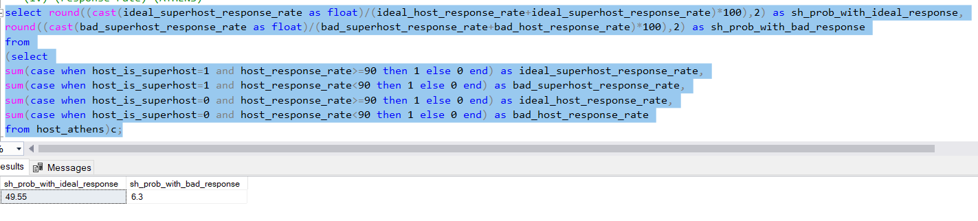
(a)Analyze different metrics to draw the distinction between Super Host and Other Hosts: To achieve this, you can use the following metrics and explore a few yourself as well. Acceptance rate, response rate, instant booking, profile picture, identity verified, review review scores, average no of bookings per month, etc.
(iv) (response rate) (THESSALONIKI)
(iv) (response rate) (ATHENS)

Slide 10
GRAPHICAL REPRESENTATION
(iv) (response rate) (THESSALONIKI)
(iv) (response rate) (ATHENS)

Slide 11
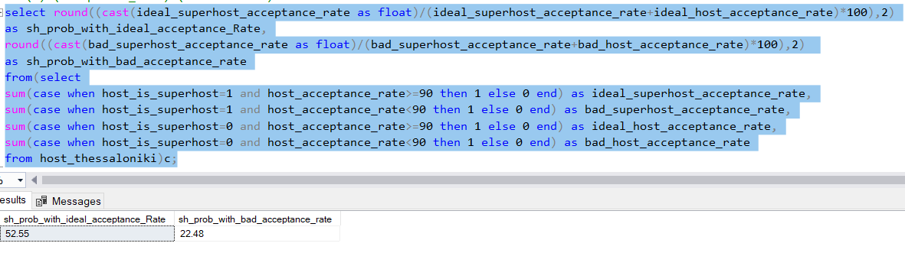
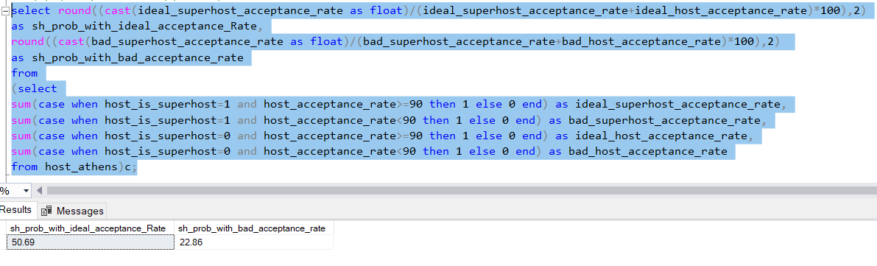
(a)Analyze different metrics to draw the distinction between Super Host and Other Hosts: To achieve this, you can use the following metrics and explore a few yourself as well. Acceptance rate, response rate, instant booking, profile picture, identity verified, review review scores, average no of bookings per month, etc.
(v) (acceptance rate) (THESSALONIKI)
(v) (acceptance rate) (ATHENS)

Slide 12
GRAPHICAL REPRESENTATION
(v) (acceptance rate) (THESSALONIKI)
(v) (acceptance rate) (ATHENS)

Slide 13
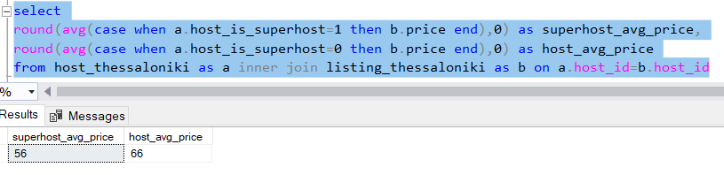
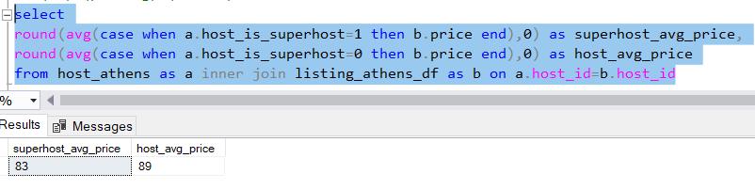
(a)Analyze different metrics to draw the distinction between Super Host and Other Hosts: To achieve this, you can use the following metrics and explore a few yourself as well. Acceptance rate, response rate, instant booking, profile picture, identity verified, review review scores, average no of bookings per month, etc.
(vi) (pricing) (THESSALONIKI)
(vi) (pricing) (ATHENS)

Slide 14
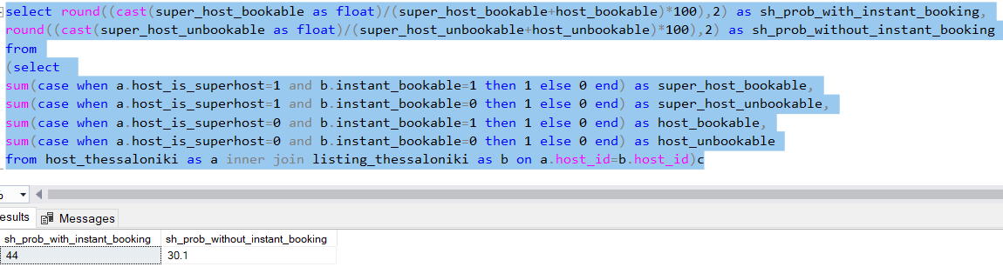
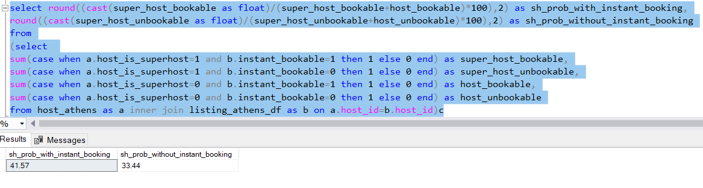
(a)Analyze different metrics to draw the distinction between Super Host and Other Hosts: To achieve this, you can use the following metrics and explore a few yourself as well. Acceptance rate, response rate, instant booking, profile picture, identity verified, review review scores, average no of bookings per month, etc.
(vii) (instant bookable) (THESSALONIKI)
(vii) (instant bookable) (ATHENS)

Slide 15
GRAPHICAL REPRESENTATION
(vii) (instant bookable) (THESSALONIKI)
(vii) (instant bookable) (ATHENS)

Slide 16
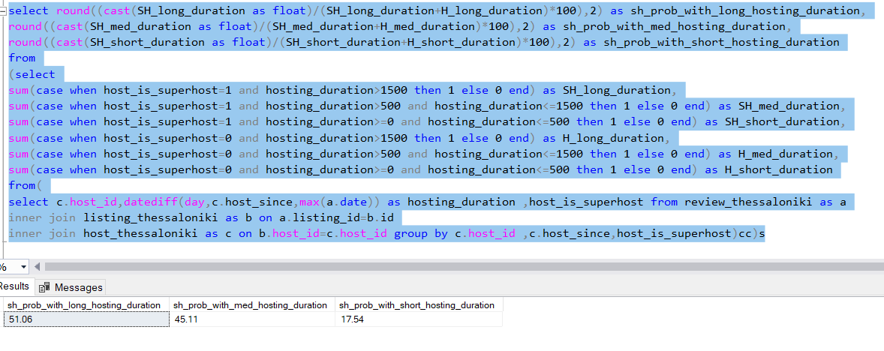
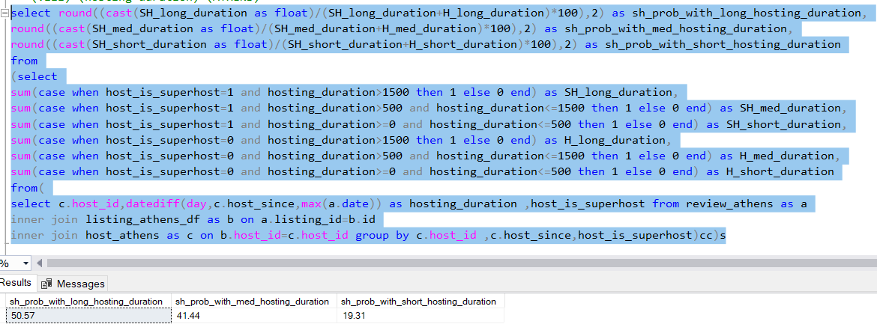
(a)Analyze different metrics to draw the distinction between Super Host and Other Hosts: To achieve this, you can use the following metrics and explore a few yourself as well. Acceptance rate, response rate, instant booking, profile picture, identity verified, review review scores, average no of bookings per month, etc.
(viii) (hosting duration) (THESSALONIKI)
(viii) (hosting duration) (ATHENS)

Slide 17
GRAPHICAL REPRESENTATION
(viii) (hosting duration) (THESSALONIKI)
(viii) (hosting duration) (ATHENS)

Slide 18
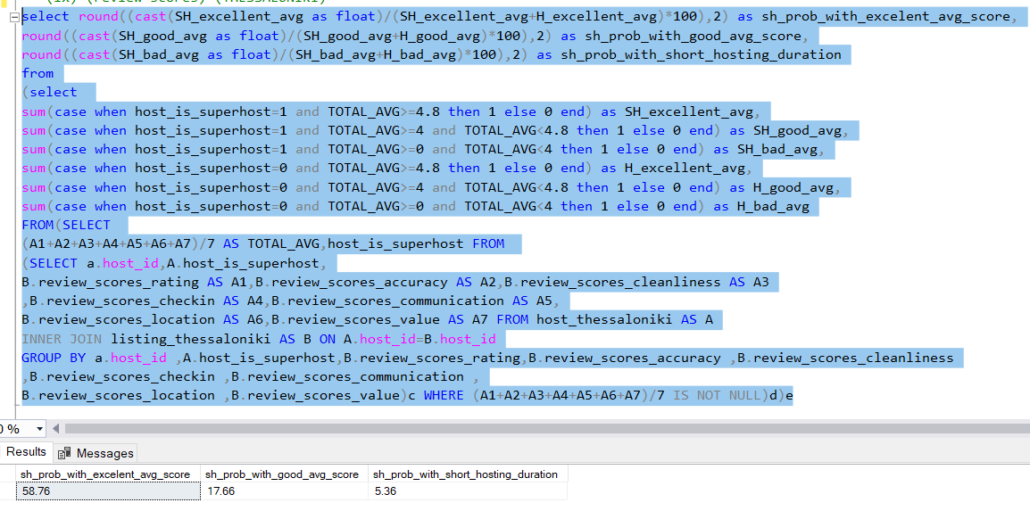
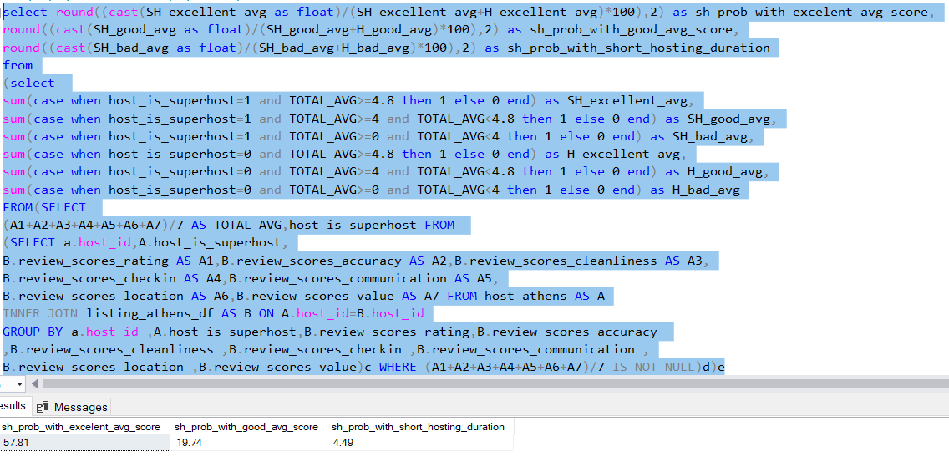
(a)Analyze different metrics to draw the distinction between Super Host and Other Hosts: To achieve this, you can use the following metrics and explore a few yourself as well. Acceptance rate, response rate, instant booking, profile picture, identity verified, review review scores, average no of bookings per month, etc.
(ix) (review scores) (THESSALONIKI)
(ix) (review scores) (ATHENS)

Slide 19
GRAPHICAL REPRESENTATION
(ix) (review scores) (THESSALONIKI)
(ix) (review scores) (ATHENS)

Slide 20
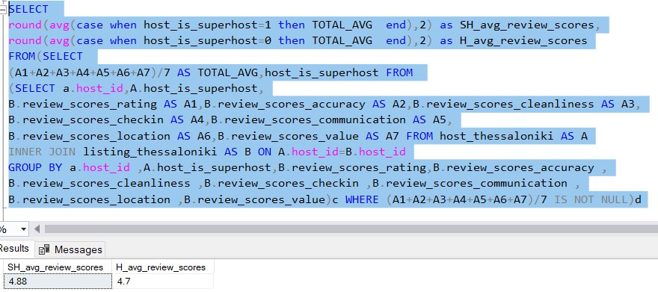
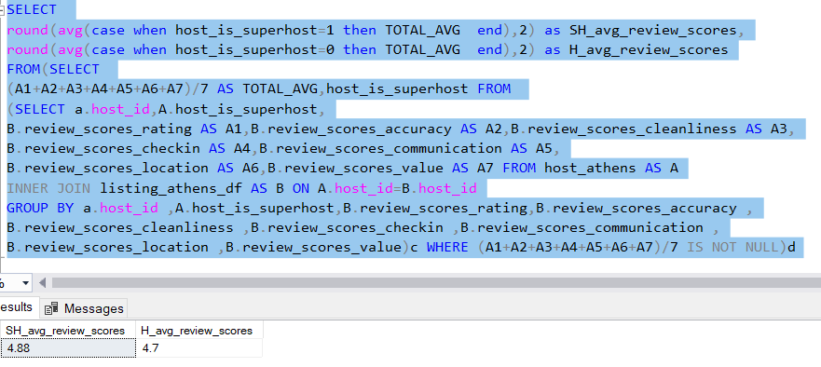
(b) Using the above analysis, identify top 3 crucial metrics one needs to maintain to become a Super Host and also, find their average values.
(i) (average review scores) (THESSALONIKI)
(i) (average review scores) (ATHENS)

Slide 21
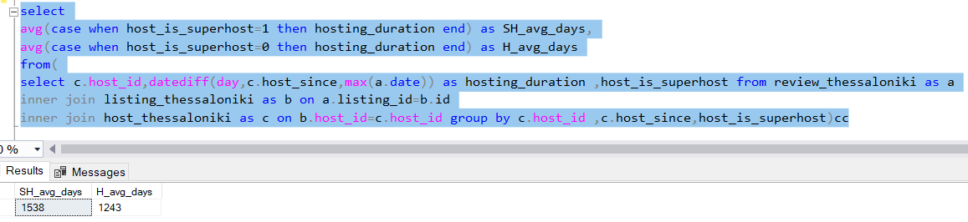
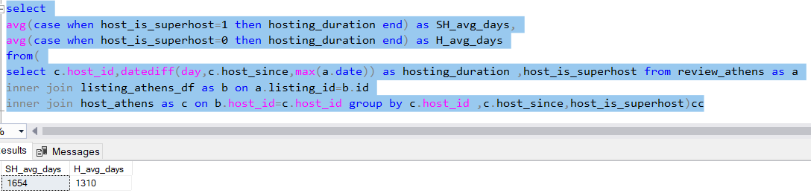
(b) Using the above analysis, identify top 3 crucial metrics one needs to maintain to become a Super Host and also, find their average values.
(ii) average days (THESSALONIKI)
(ii) average days (ATHENS)

Slide 22
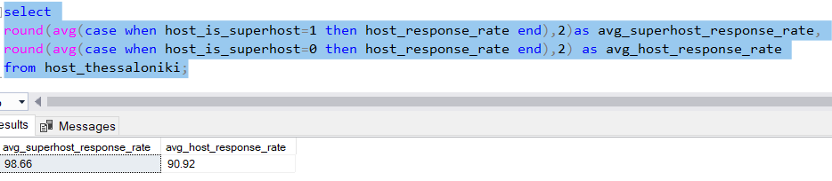
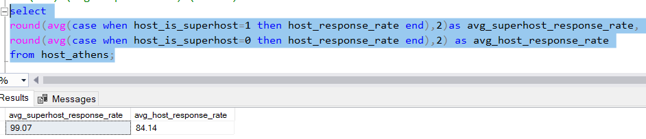
(b) Using the above analysis, identify top 3 crucial metrics one needs to maintain to become a Super Host and also, find their average values.
(iii) (average response rate) (THESSALONIKI)
(iii) (average response rate) (ATHENS)

Slide 23
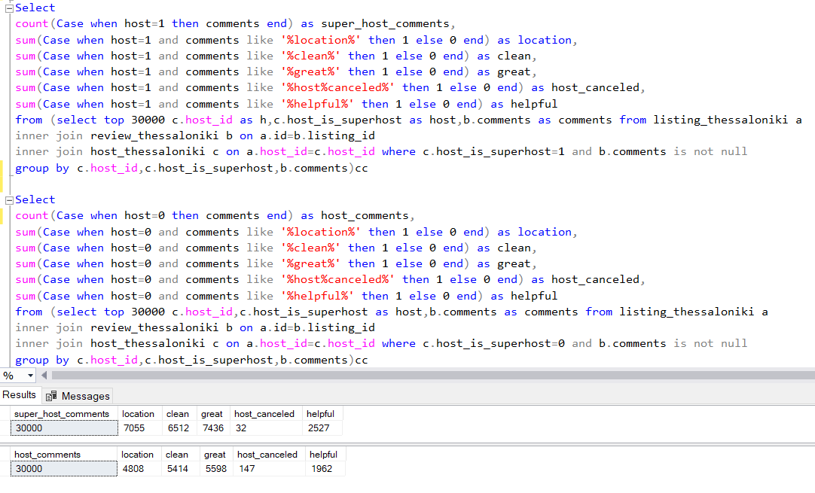
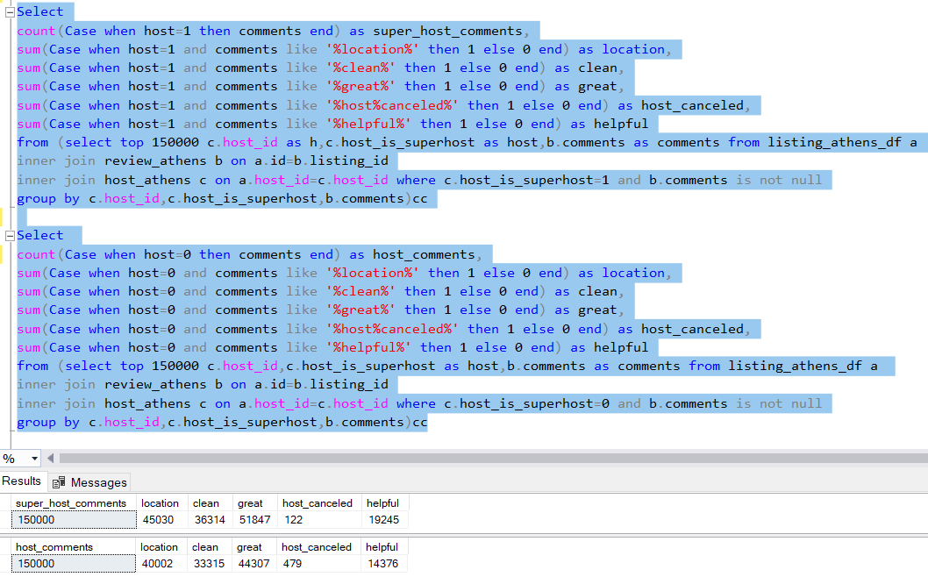
(c) Analyze how does the comments of reviewers vary for listings of Super Hosts vs Other Hosts(Extract words from the comments provided by the reviewers
SUPER HOST VS HOST COMMENTS (THESSALONIKI)
SUPER HOST VS HOST COMMENTS (ATHENS)

Slide 24
GRAPHICAL REPRESENTATION
SUPER HOST VS HOST COMMENTS (THESSALONIKI)
SUPER HOST VS HOST COMMENTS (ATHENS)

Slide 25
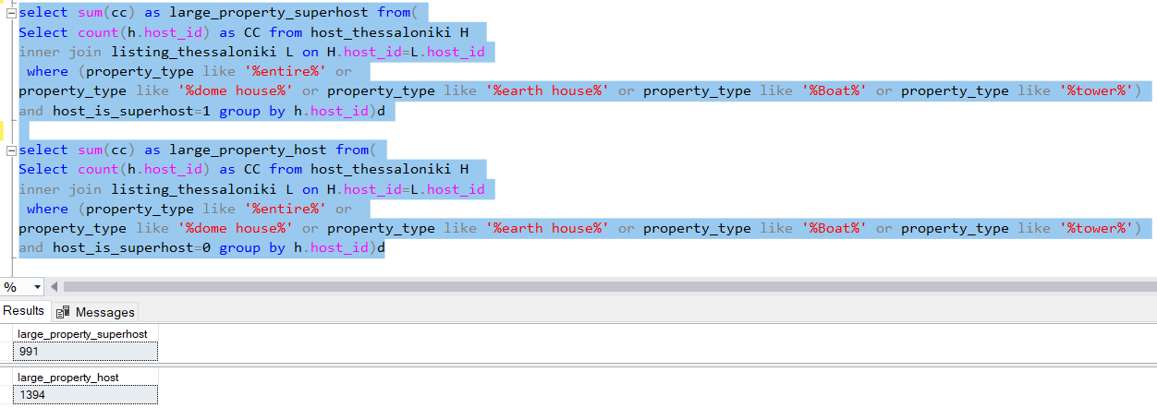
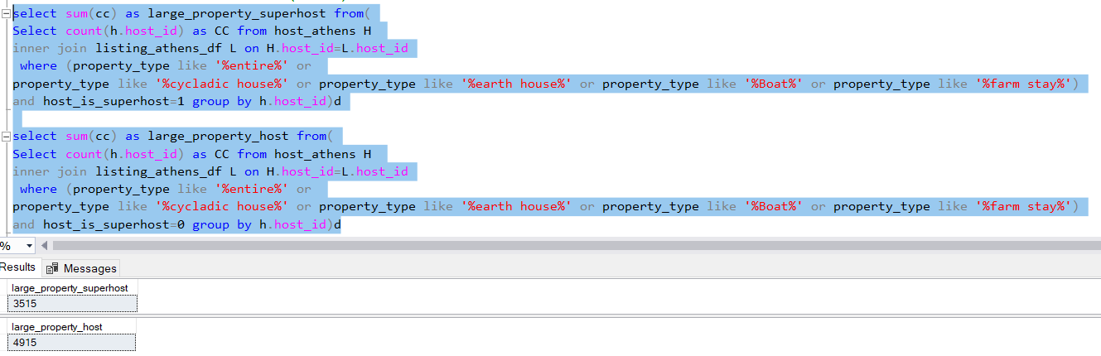
(d)Analyze do Super Hosts tend to have large property types as compared to Other Hosts
SUPER HOST VS HOST LARGE PROPERTY (THESSALONIKI)
SUPER HOST VS HOST LARGE PROPERTY (ATHENS)

Slide 26
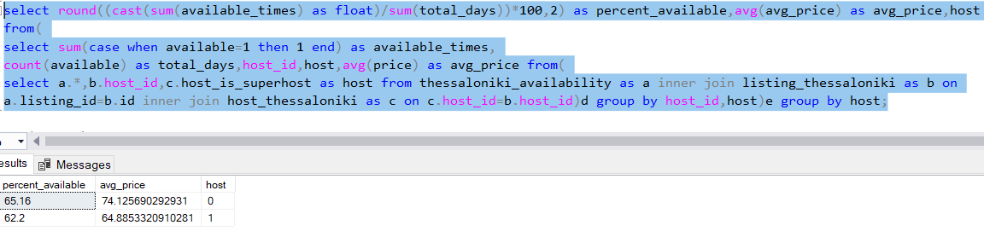
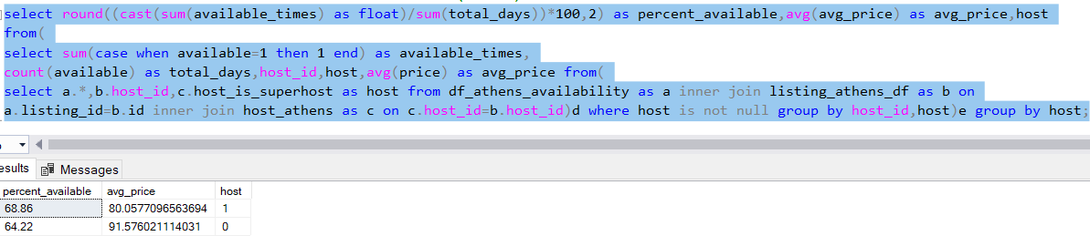
(e)Analyze the average price and availability of the listings for the upcoming year between Super Hosts and Other Hosts.
AVERAGE PRICE AND AVAILABILITY FOR HOST VS SUPERHOST (THESSALONIKI)
AVERAGE PRICE AND AVAILABILITY FOR HOST VS SUPERHOST (ATHENS)

Slide 27
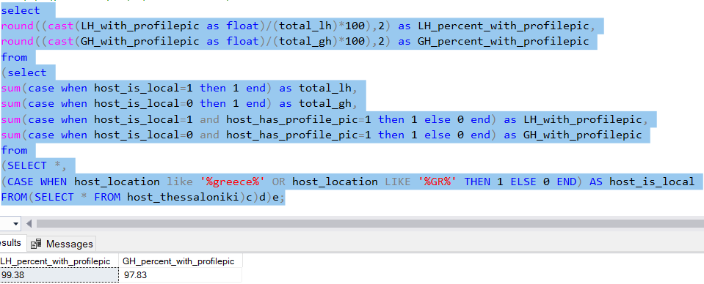
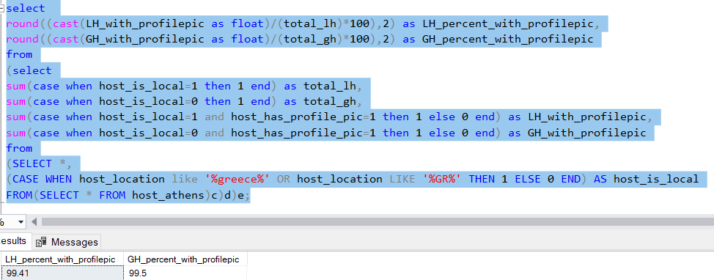
(f) Analyze if there is some difference in above mentioned trends between Local Hosts or Hosts residing in other locations
(i) (profile pic) (THESSALONIKI)
(i) (profile pic) (ATHENS)

Slide 28
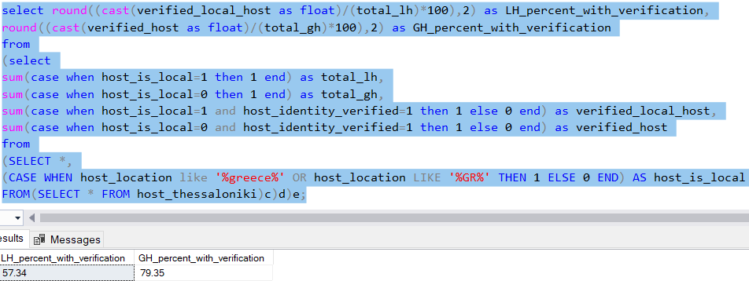
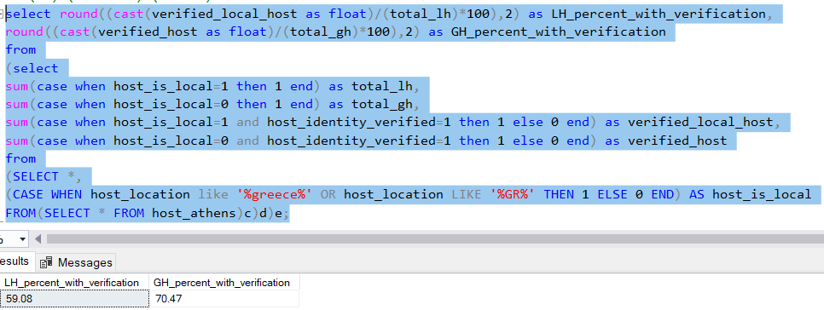
(f) Analyze if there is some difference in above mentioned trends between Local Hosts or Hosts residing in other locations
(ii) (verified) (THESSALONIKI)
(ii) (verified) (ATHENS)

Slide 29
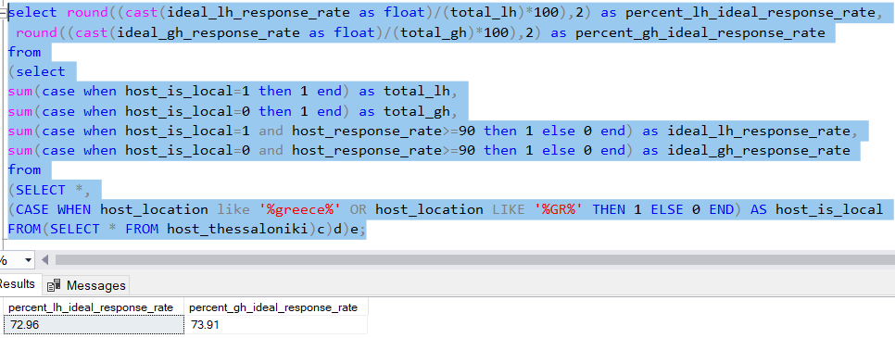
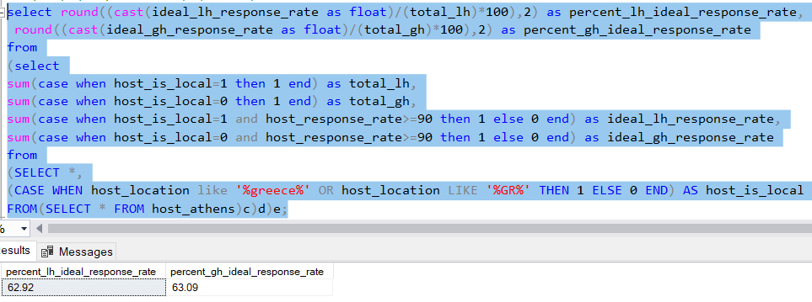
(f) Analyze if there is some difference in above mentioned trends between Local Hosts or Hosts residing in other locations
(iii) (response rate) (THESSALONIKI)
(iii) (response rate) (ATHENS)

Slide 30
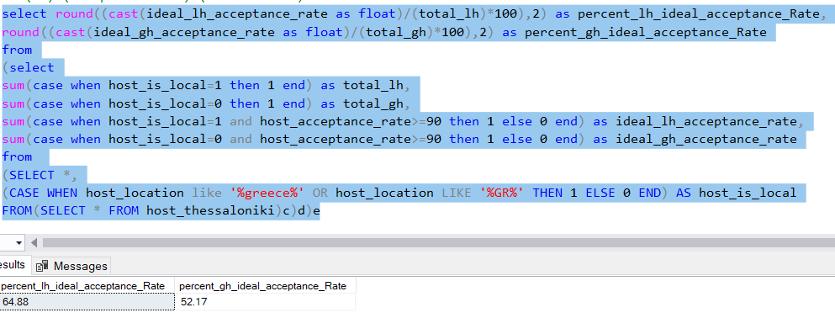
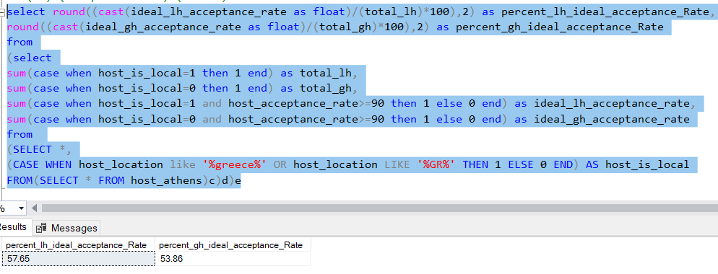
(f) Analyze if there is some difference in above mentioned trends between Local Hosts or Hosts residing in other locations
(iv) (acceptance rate) (THESSALONIKI)
(iv) (acceptance rate) (ATHENS)

Slide 31
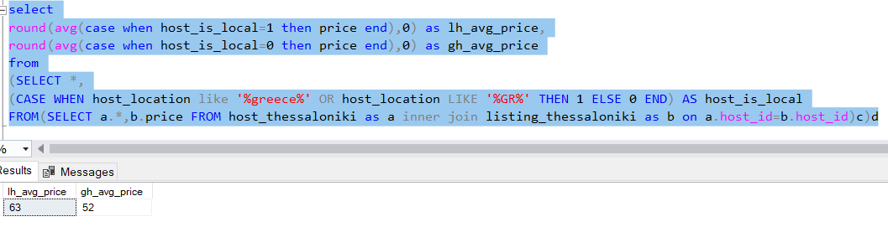
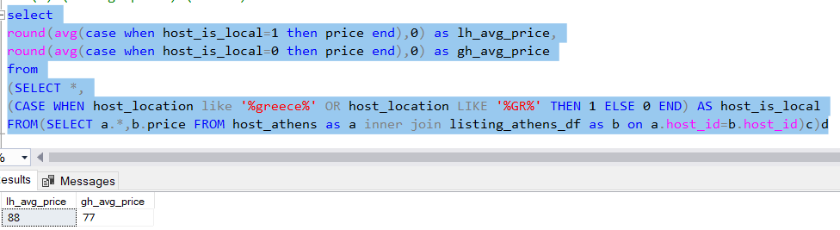
(f) Analyze if there is some difference in above mentioned trends between Local Hosts or Hosts residing in other locations
(v) (average price) (THESSALONIKI)
(v) (average price) (ATHENS)

Slide 32
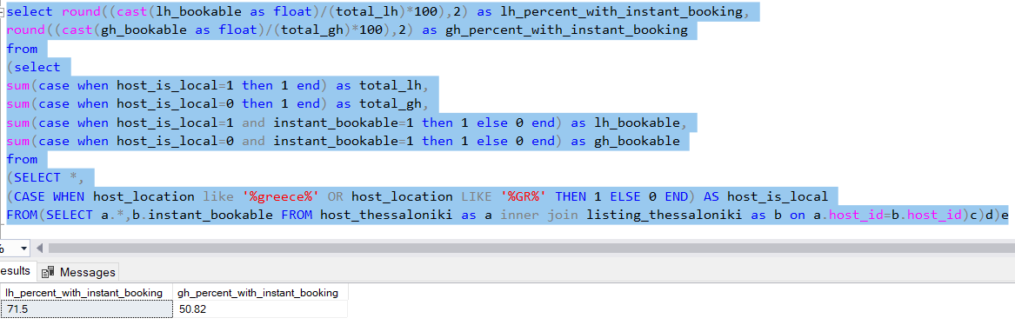
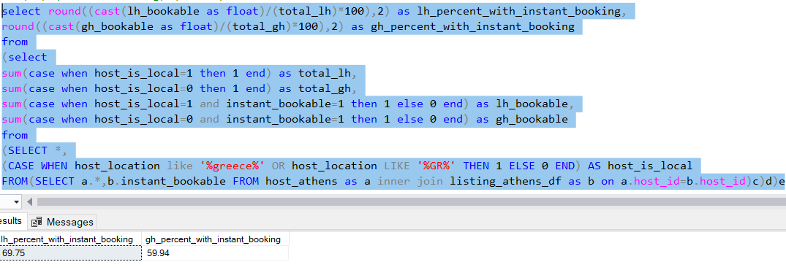
(f) Analyze if there is some difference in above mentioned trends between Local Hosts or Hosts residing in other locations
(vi) (instant booking) (THESSALONIKI)
(vi) (instant booking) (ATHENS)

Slide 33
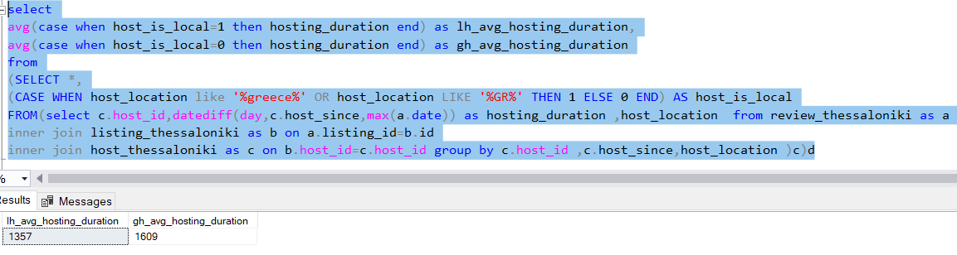
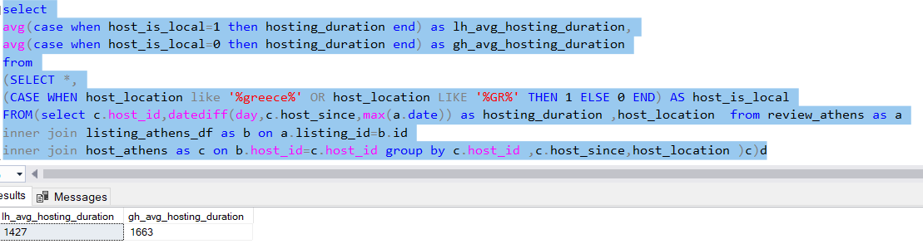
(f) Analyze if there is some difference in above mentioned trends between Local Hosts or Hosts residing in other locations
(vii) (hosting duration) (THESSALONIKI)
(vii) (hosting duration) (ATHENS)

Slide 34
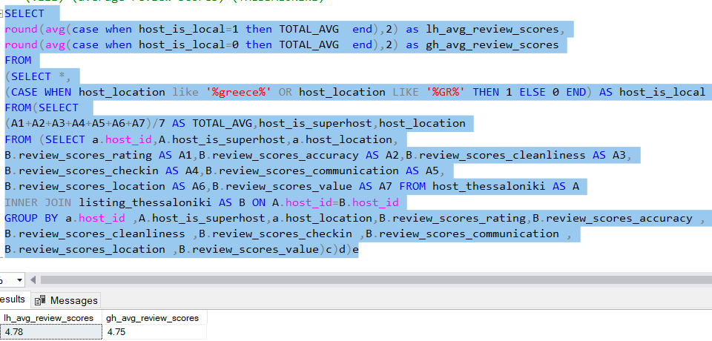
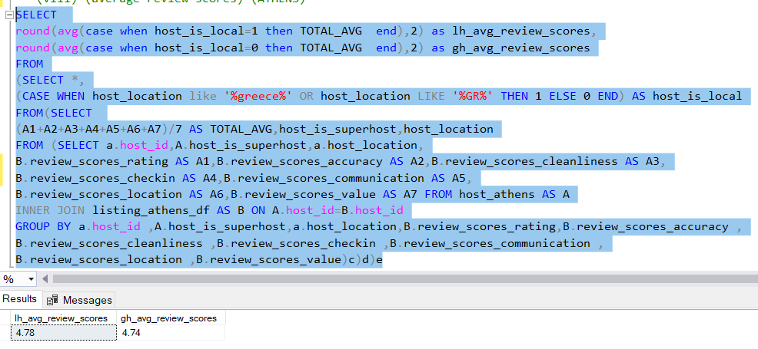
(f) Analyze if there is some difference in above mentioned trends between Local Hosts or Hosts residing in other locations
(viii) (average review scores) (THESSALONIKI)
(viii) (average review scores) (ATHENS)

Slide 35
KEY FINDINGS FROM OUR ANALYSIS
RESPONSE RATE OF SUPERHOST IS 99.07% ON AN AVERAGE WHEREAS IT IS ONLY 84.1%FOR NORMAL HOST.
LESSER THE RESPONSE TIME GREATER IS THE CHANCE OF BEING A SUPERHOST.
GREATER THE HOSTING DURATION GREATER IS THE CHANCE OF BEING A SUPERHOST.
HIGHER THE AGGREGRATE RATING SCORE HIGHER CHANCE OF BEING A SUPERHOST.
PROFILE PIC UPDATED HOSTS HAVE A GREATER CHANCE OF BEING A SUPERHOST.

Slide 36
THANK YOU!

